Slide 1
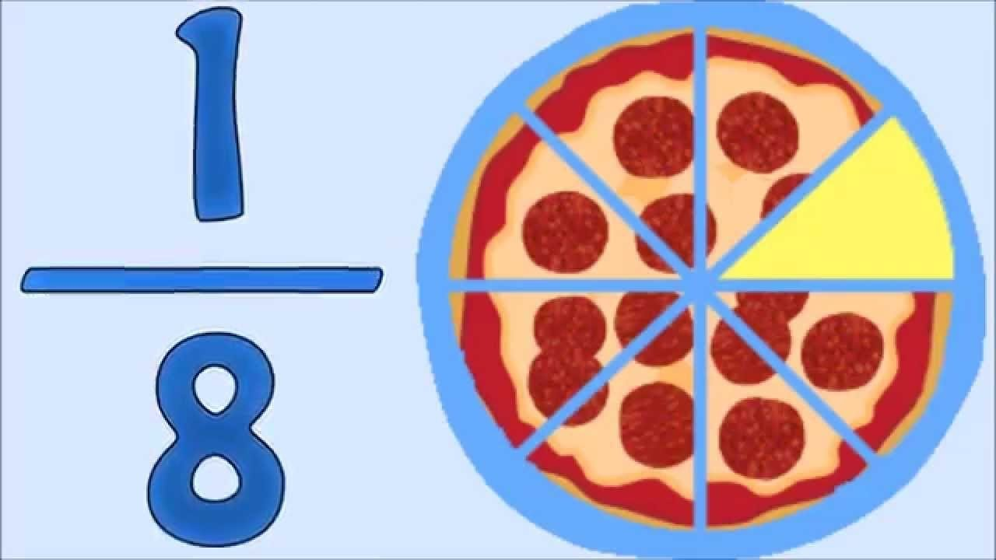

Slide 2
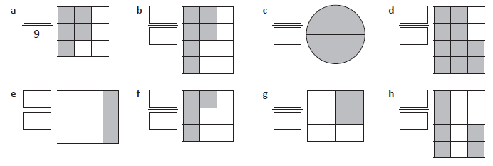
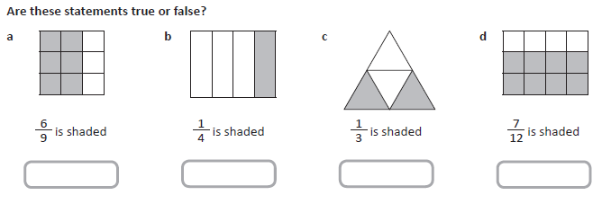
What part of the fraction is shaded and then what part is not shaded?

Slide 3
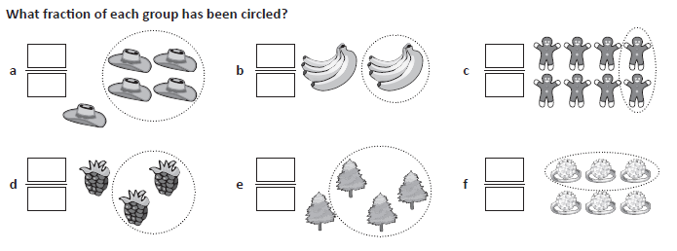
There are other ways to represent fractions.
Fractions of a collections

Slide 4
There are other ways to represent fractions.
Fractions in measurement…

Slide 5
Fractions in collection
Can you work out an easier way to do this?

Slide 6
Fractions in collection
Answer the following using your new method.

Slide 7
